Slide 1


Rohini Patil
01-Feb-2025

Slide 2

Outline
Executive Summary
Introduction
Methodology
Results
Conclusion
Appendix

Slide 3
Executive Summary
Summary of methodologies
SpaceX Data Collection using SpaceX API
SpaceX Data Collection using Web Scrapping
SpaceX Data Wrangling
SpaceX Exploratory Data Analysis using SQL
SpaceX EDA DataViz using Python Pandas and Matplotlib
SpaceX Launch Sites Analysis with Folium –Visual Analytics and Ploty Dash
SpaceX Machine Learning Landing Prediction
Summary of all results
EDA Results
Interactive Visual Analytics And Dashboards
Predictive Analysis(Classification)

Slide 4
Introduction
Project background and context
SpaceX advertises Falcon 9 rocket launches on its website with a cost of 62 million dollars; other providers cost upward of 165 million dollars each, much of the savings is because SpaceX can reuse the first stage. Therefore, if we can determine if the first stage will land, we can determine the cost of a launch. This information can be used if an alternate company wants to bid against SpaceX for a rocket launch
Problems you want to find answers
In this capstone, we will predict if the Falcon 9 first stage will land successfully using data from Falcon 9 rocket launches advertise on its websites.

Slide 5

Section 1

Slide 6
Methodology
Executive Summary
Data collection methodology:
Describe how data was collected
Perform data wrangling
Describe how data was processed
Perform exploratory data analysis (EDA) using visualization and SQL
Perform interactive visual analytics using Folium and Plotly Dash
Perform predictive analysis using classification models
How to build, tune, evaluate classification models

Slide 7
Data Collection
Description of how SpaceX Falcon9 data was collected.
SpaceX API: Data was first collected using the SpaceX API (a RESTful API) by making a GET request. This involved defining helper functions to extract information using identification numbers in the launch data, then requesting rocket launch data from the SpaceX API URL.
JSON Parsing: To make the JSON results more consistent, the SpaceX launch data was requested and parsed using the GET request, and the response content was decoded as a JSON result, which was then converted into a Pandas Data Frame.
Web Scraping: Additionally, web scraping was performed to collect Falcon 9 historical launch records from a Wikipedia page titled "List of Falcon 9 and Falcon Heavy launches." The launch records stored in HTML were extracted using Beautiful Soup and request libraries, parsed, and converted into a Pandas Data Frame.

Slide 8
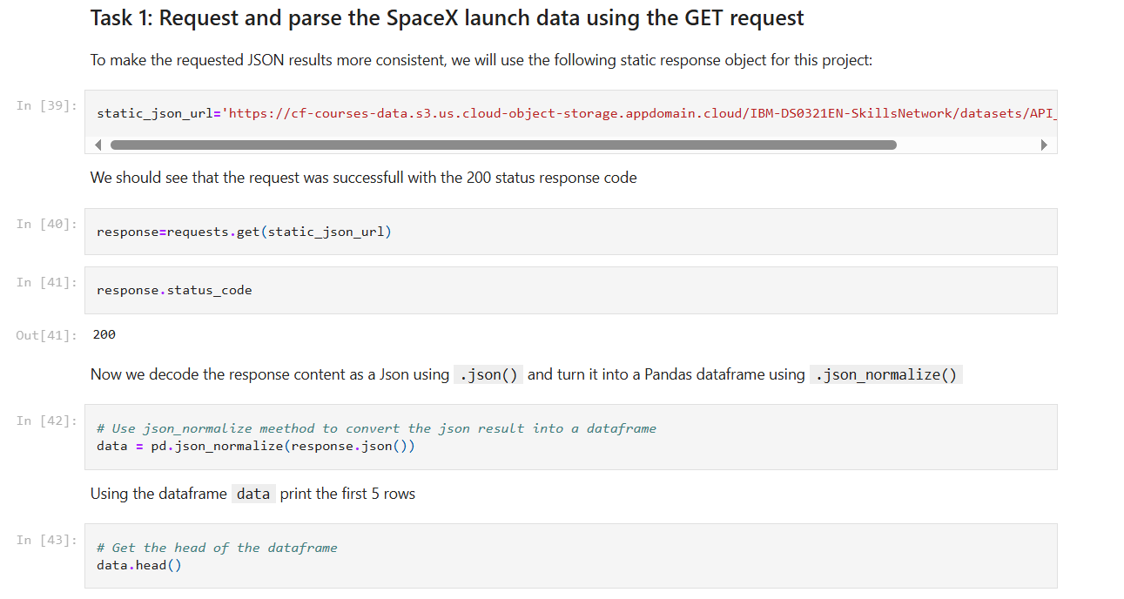
Data Collection – SpaceX API
Data collected using SpaceX API(a Restful API) by making a GET request to the SpaceX API then requested and parsed the SpaceX launch data using the GET request and decoded the response content as a Json result which is then converted into a Pandas Data Frame.
Here is the GitHub URL of the completed SpaceX API calls notebook (Applied-Data-Science-Capstone/spacex-data-collection-api.ipynb at main · RohiniPatil0/Applied-Data-Science-Capstone), as an external reference and peer-review purpose
Place your flowchart of SpaceX API calls here

Slide 9
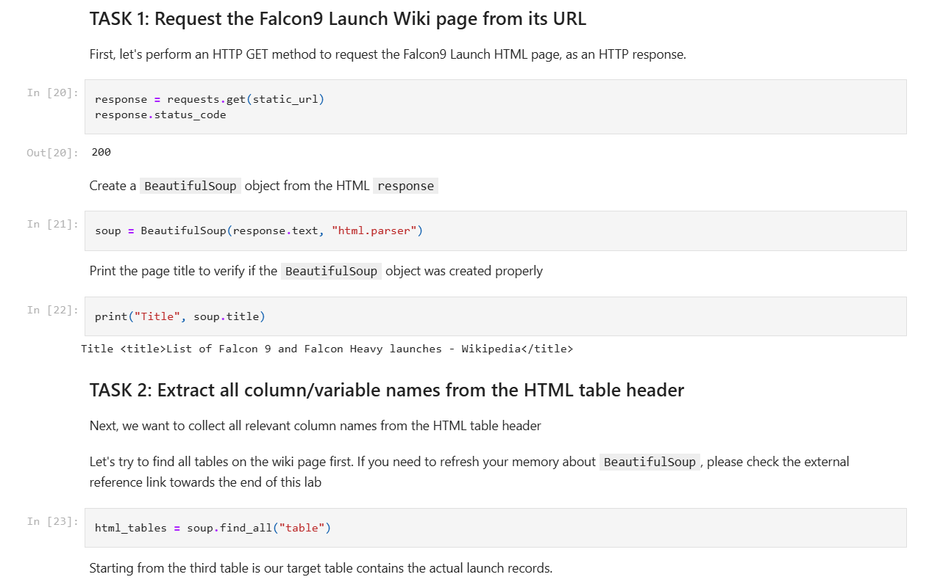
Data Collection - Scraping
Performed Web scrapping to collect Falcon9 historical launch records from a Wikipedia using Beautiful Soup and request, to extract the Falcon 9 records from HTML table of the Wikipedia page then created a data frame by parsing the launch HTML.
Here is the GitHub URL of the completed web scraping notebook, as an external reference and peer-review purpose
Applied-Data-Science-Capstone/webscraping.ipynb at main · RohiniPatil0/Applied-Data-Science-Capstone
Place your flowchart of web scraping here

Slide 10
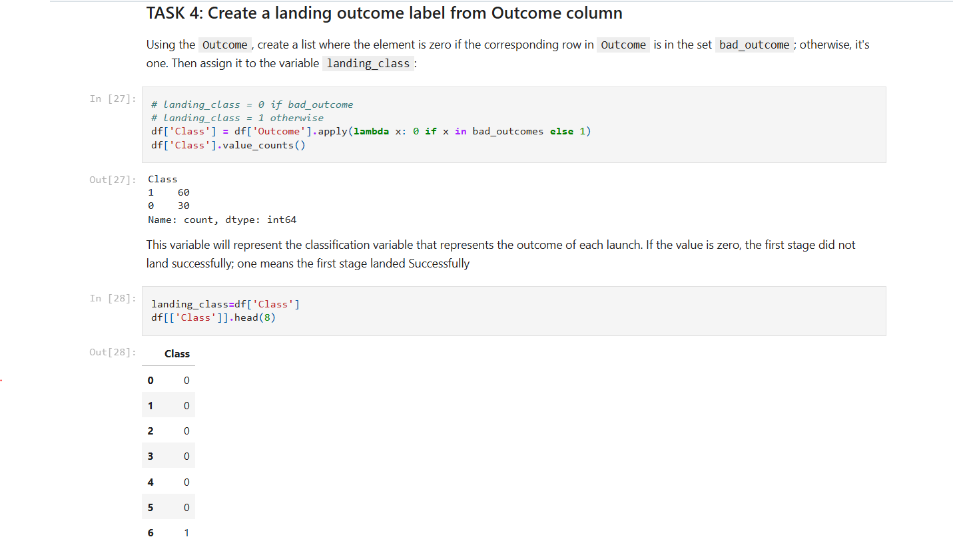
Data Wrangling
After obtaining and creating a Pandas DF from the collected data, data was filtered using the Booster Version column to only keep the Falcon 9 launches, then dealt with the missing data values in the LandingPad and PayloadMass columns. For the PayloadMass, missing data values were replaced using mean value of column.
Also performed some Exploratory Data Analysis (EDA) to find some patterns in the data and determine what would be the label for training supervised models.
Here is the GitHub URL of the completed data wrangling related notebooks.
Applied-Data-Science-Capstone/spacex-Data wrangling.ipynb at main · RohiniPatil0/Applied-Data-Science-Capstone

Slide 11
EDA with Data Visualization
Performed data Analysis and Feature Engineering using Pandas and Matplotlib. i.e.
Exploratory Data Analysis
Preparing Data
Feature Engineering
Used scatter plots to Visualize the relationship between:
Flight Number and Launch Site
Payload and Launch Site
Flight Number and Orbit type
Payload and Orbit type
Used Bar chart to Visualize the relationship between success rate of each orbit type
Line plot to Visualize the launch success yearly trend
Here is the GitHub URL of your completed EDA with data visualization notebook
Applied-Data-Science-Capstone/edadataviz.ipynb at main · RohiniPatil0/Applied-Data-Science-Capstone

Slide 12
EDA with SQL
Display the names of the unique launch sites in the space mission
Display 5 records where launch sites begin with the string 'CCA’
Display the total payload mass carried by boosters launched by NASA (CRS)
Display average payload mass carried by booster version F9 v1.1
List the date when the first succesful landing outcome in ground pad was acheived.
List the names of the boosters which have success in drone ship and have payload mass greater than 4000 but less than 6000

Slide 13
EDA with SQL(cont.….)
List the total number of successful and failure mission outcomes
List the names of the booster_versions which have carried the maximum payload mass. Use a subquery
List the records which will display the month names, failure landing_outcomes in drone ship ,booster versions, launch_site for the months in year 2015.
Rank the count of landing outcomes (such as Failure (drone ship) or Success (ground pad)) between the date 2010-06-04 and 2017-03-20, in descending order.
Here is the GitHub URL
Applied-Data-Science-Capstone/eda-sql-coursera_sqllite.ipynb at main · RohiniPatil0/Applied-Data-Science-Capstone

Slide 14
Build an Interactive Map with Folium
Created Folium Map to mark all launch sites and created map objects such as markers, circles, lines to mark the success or failure of launch for each launch site.
Created a launch set outcomes(failure=0 or success=1)
Here is the GitHub URL of your completed interactive map with Folium map, as an external reference and peer-review purpose
Applied-Data-Science-Capstone/launch_site_location.ipynb at main · RohiniPatil0/Applied-Data-Science-Capstone

Slide 15
Build a Dashboard with Plotly Dash
Built an interactive dashboard application with Ploty Dash By
Added a Launch Site Drop-down Input Component
Added a callback function to render success-pie-chart based on selected site dropdown
Added a Range Slider to Select Payload
Added a callback function to render the success-payload-scatter-chart scatter plot.
Here is the GitHub URL of your completed Plotly Dash lab, as an external reference and peer-review purpose
Applied-Data-Science-Capstone/spacex_dash_app.py at main · RohiniPatil0/Applied-Data-Science-Capstone

Slide 16
Predictive Analysis (Classification)
Summary of how I built, evaluated, improved, and found the best performing classification model.
After loading the data as a Pandas Dataframe, I set out to perform exploratory Data Analysis and determine Training Labels by:
Creating a NumPy array from the column Class in data, by applying the method to_numpy() then assigned it to the variable Y as the outcome variable.
Then standardized the feature dataset (x) by transforming it using preprocessing.StandardScaler() function from Sklearn.
After which the data was split into training and testing sets using the function train_test_split from sklearn.model_selection with the test_size parameter set to 0.2 and random_state to 2.

Slide 17
Predictive Analysis (Classification)
In order to find the best ML model/method that would perform best using the test data between SVM, Classification Trees, K Nearest Neighbors and Logistic Regression:
First created an object for each of the algorithms then created a GridSearchCV object and assigned them a set of parameters for each model.
For each of the models under evaluation, the GridsearchCV object was created with cv=10, then fit the training data into the GridSearch object for each to find best Hyperparameter.
After fitting the training set, we output GridSearchCV object for each of the models, then displayed the best parameters using the data attribute best_params_ and the accuracy on the validation data using the data attribute best_score_.
Finally using the method score to calculate the accuracy on the test data for each model and plotted a confusion matrix for each using the test and predicted outcomes.

Slide 18
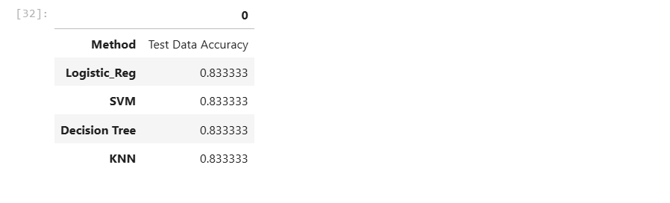
Predictive Analysis (Classification)
The table below shows the test data accuracy score for each of the methods comparing them to show which performed best using the test data between SVM, Classification Trees, k nearest neighbours and Logistic Regression.
GitHub URL of the completed predictive analysis lab
Applied-Data-Science-Capstone/SpaceX_Machine Learning Prediction_Part_5.ipynb at main · RohiniPatil0/Applied-Data-Science-Capstone

Slide 19
Results
Exploratory data analysis results
Interactive analytics demo in screenshots
Predictive analysis results

Slide 20

Section 2

Slide 21
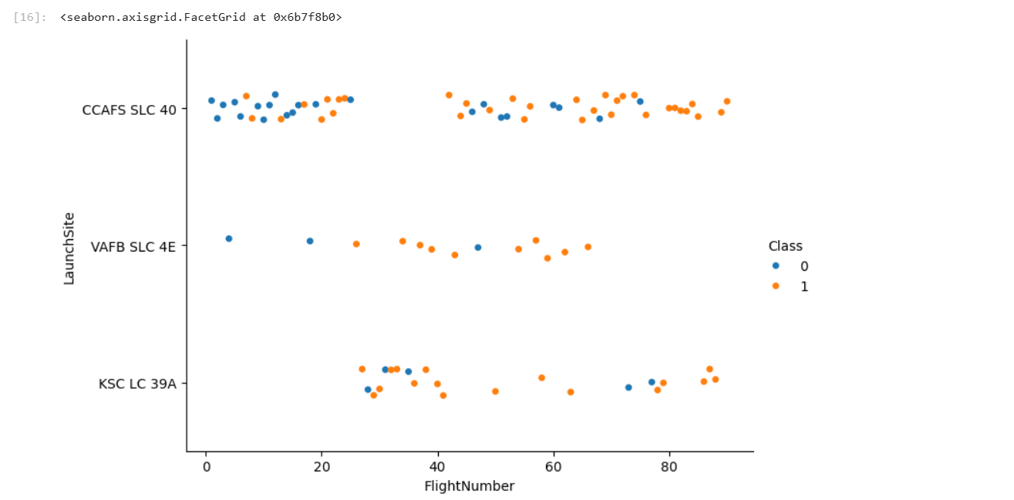
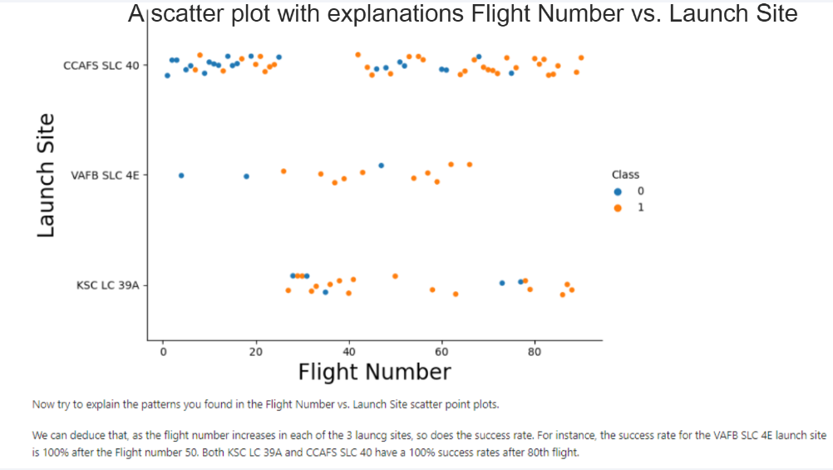
Flight Number vs. Launch Site
Show a scatter plot of Flight Number vs. Launch Site
Show the screenshot of the scatter plot with explanations

Slide 22
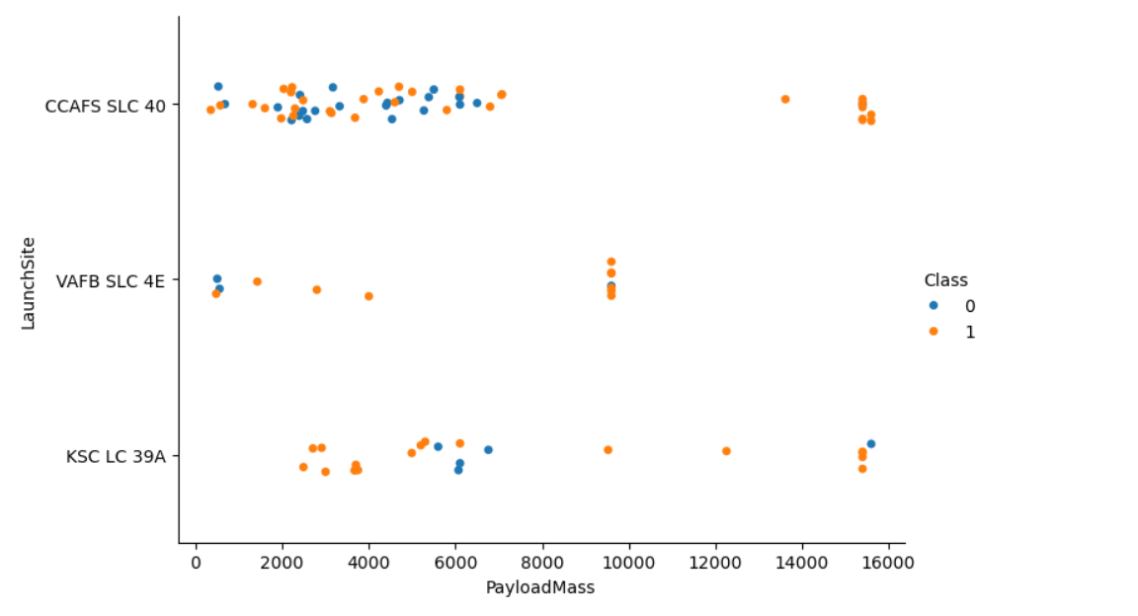
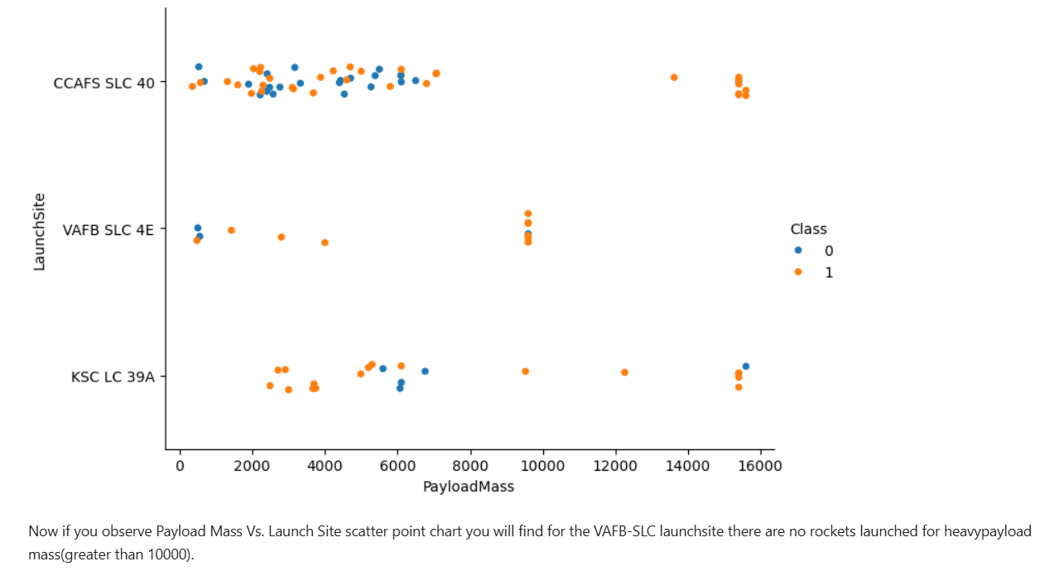
Payload vs. Launch Site
Show a scatter plot of Payload vs. Launch Site
Show the screenshot of the scatter plot with explanations

Slide 23
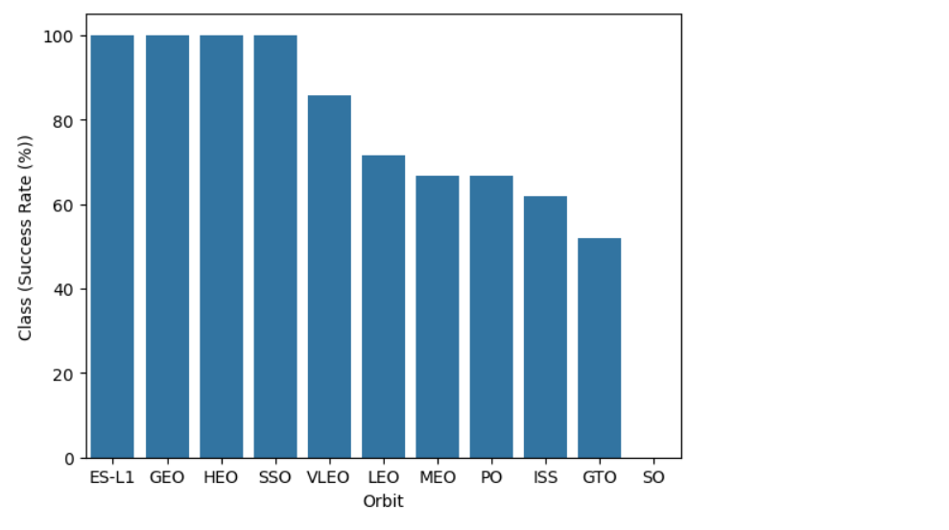
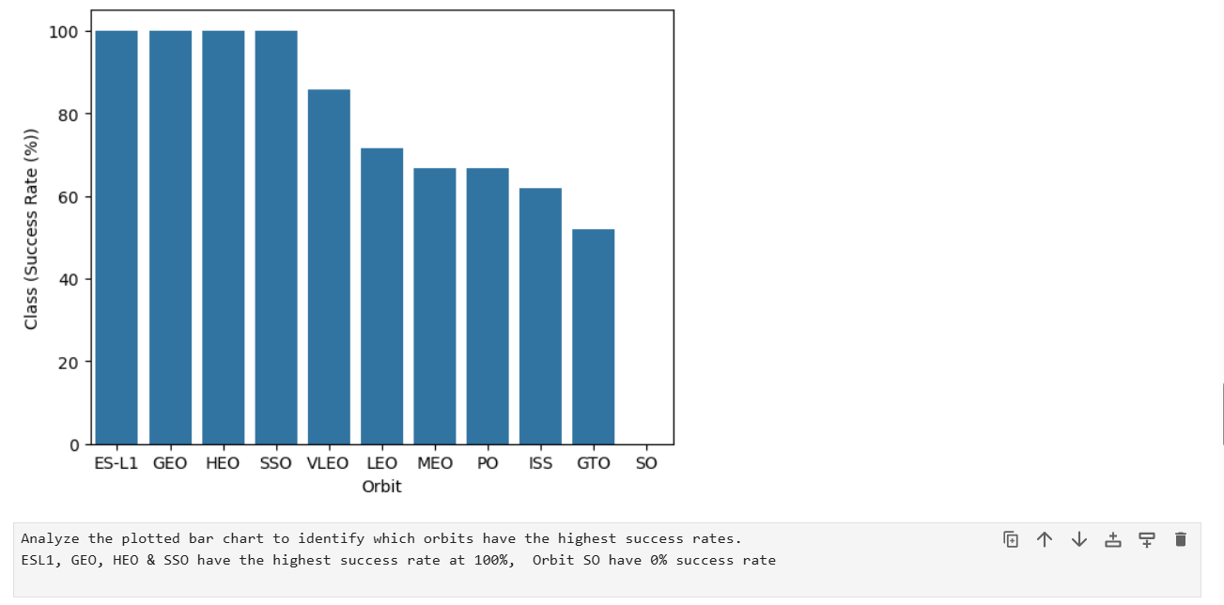
Success Rate vs. Orbit Type
Show a bar chart for the success rate of each orbit type
Show the screenshot of the scatter plot with explanations

Slide 24
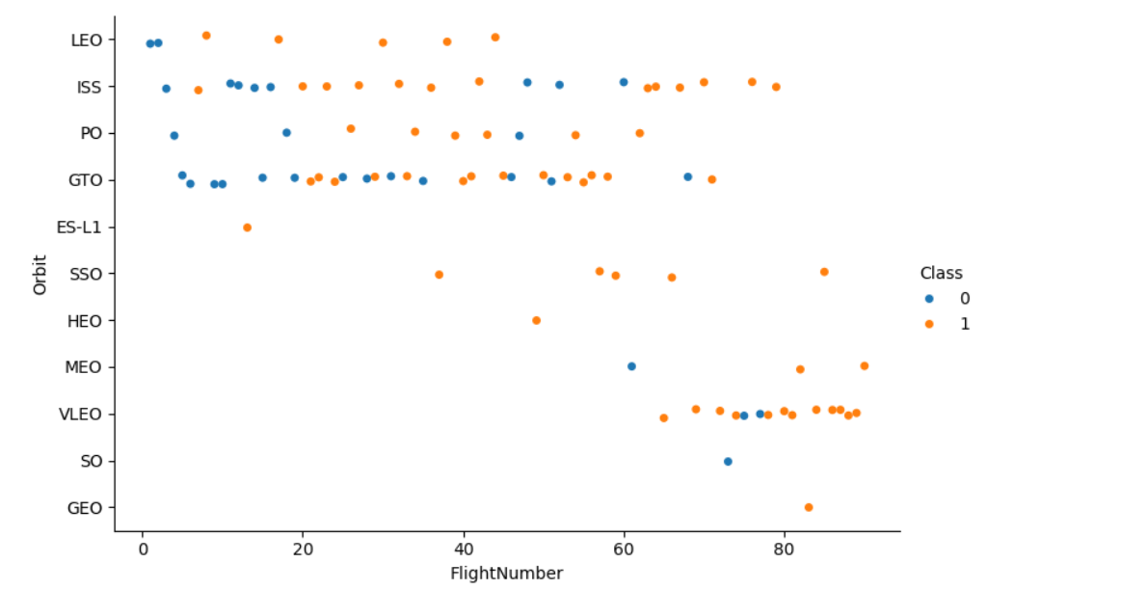
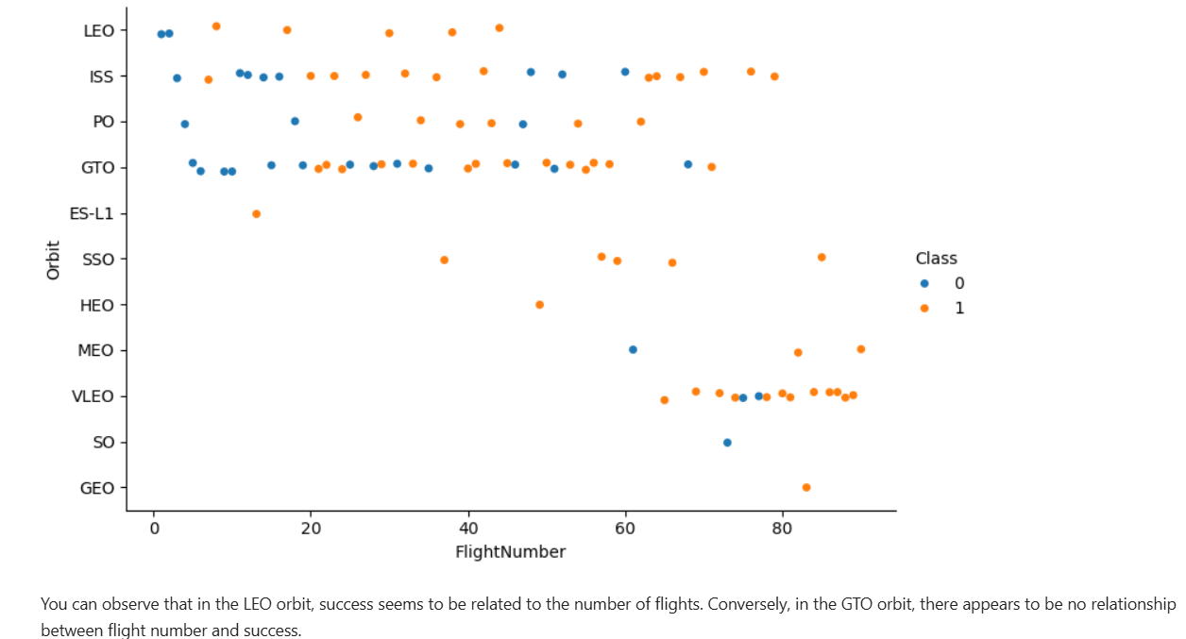
Flight Number vs. Orbit Type
Show a scatter point of Flight number vs. Orbit type
Show the screenshot of the scatter plot with explanations

Slide 25
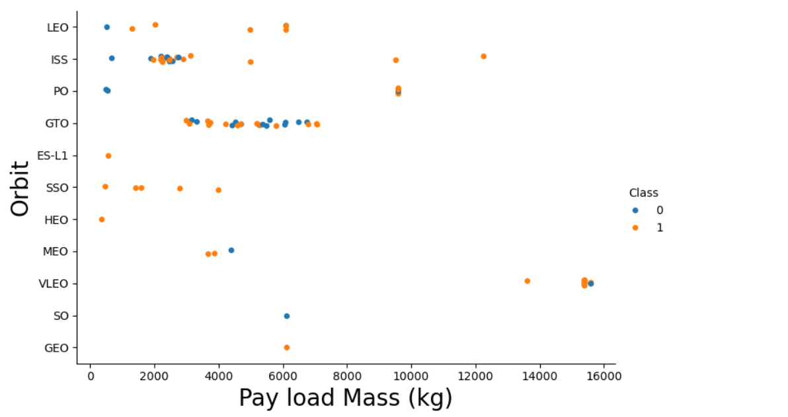
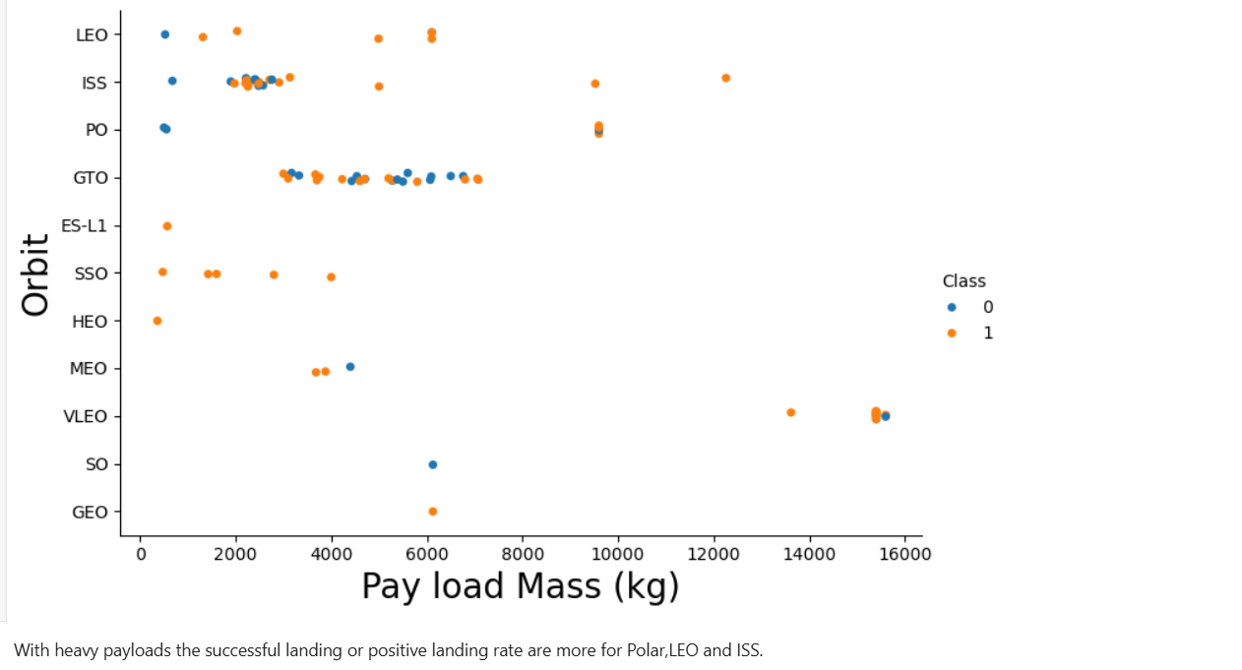
Payload vs. Orbit Type
Show a scatter point of payload vs. orbit type
Show the screenshot of the scatter plot with explanations

Slide 26
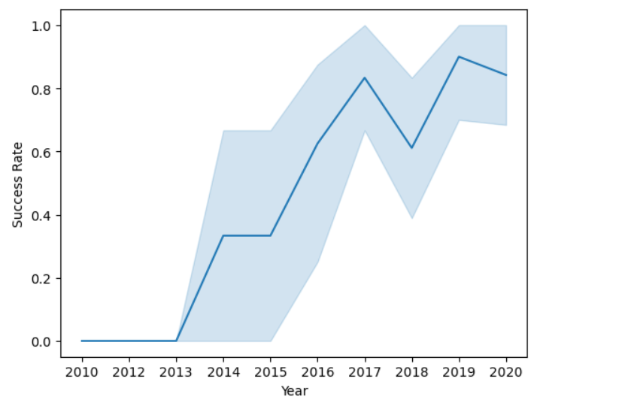
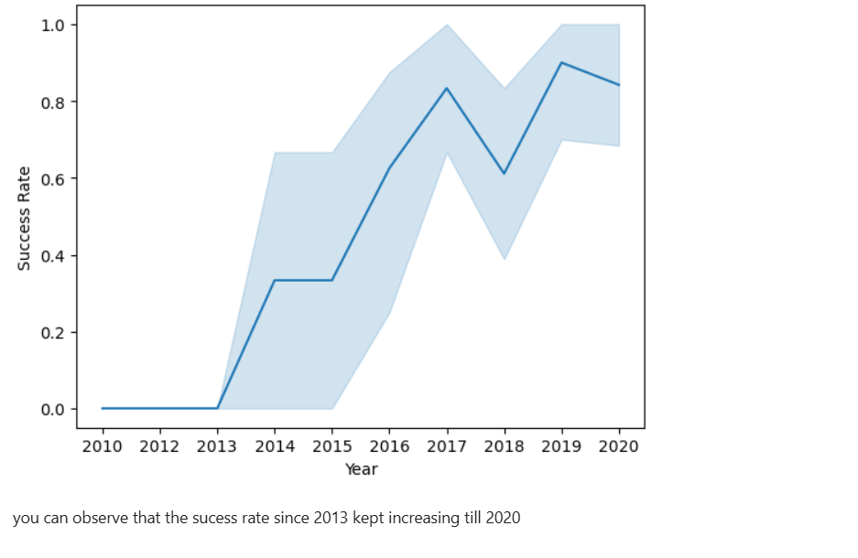
Launch Success Yearly Trend
Show a line chart of yearly average success rate
Show the screenshot of the scatter plot with explanations

Slide 27
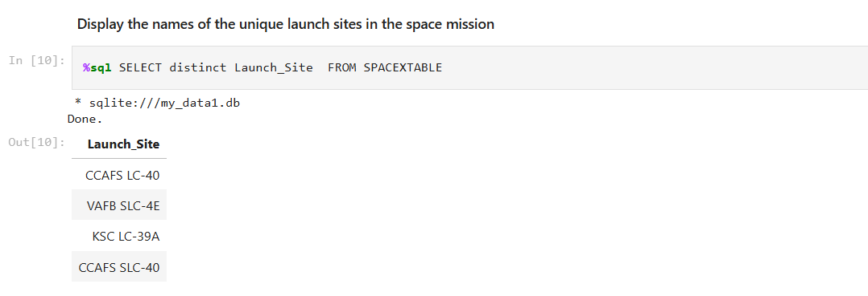
All Launch Site Names
Find the names of the unique launch sites
Distinct keyword is used to get the unique launch sites from SPACEXTABLE

Slide 28
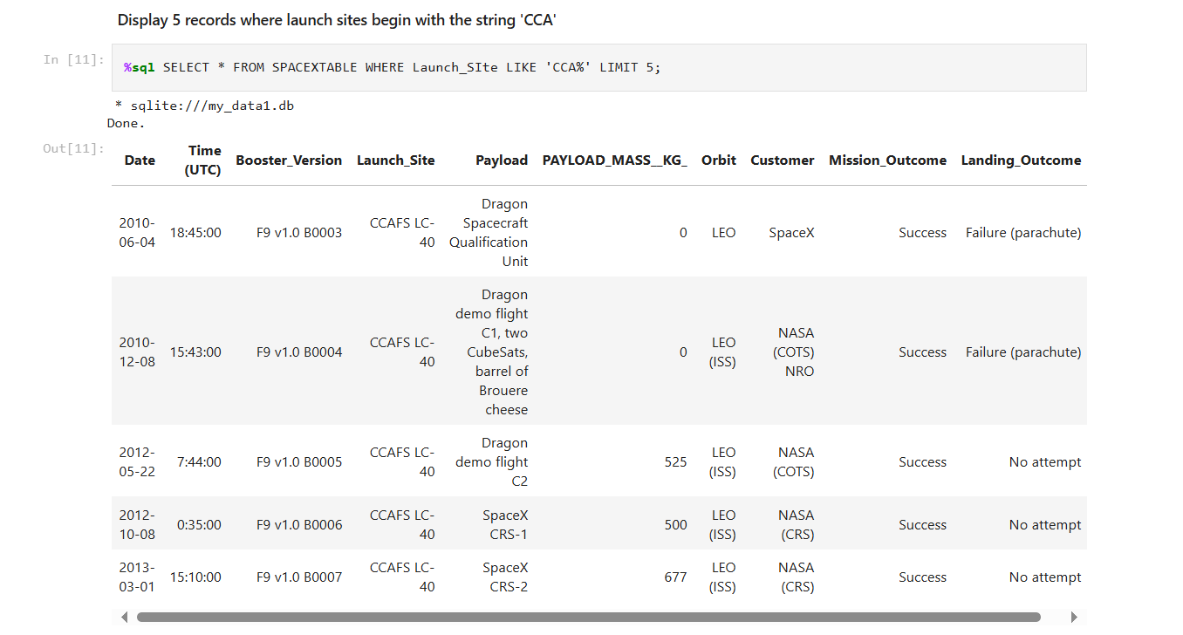
Launch Site Names Begin with 'CCA'
Find 5 records where launch sites begin with `CCA`
LIKE keyword is used to get the launch sites begin with ‘CCA’ and LIMIT keyword is used to find only 5 records.

Slide 29
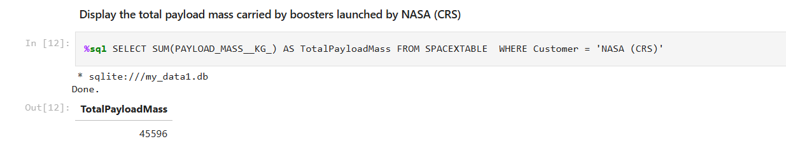
Total Payload Mass
Calculate the total payload carried by boosters from NASA
SUM function is used to calculate the total payload carried by boosters from NASA

Slide 30
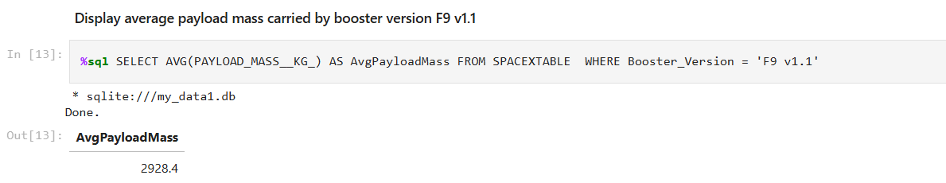
Average Payload Mass by F9 v1.1
Calculate the average payload mass carried by booster version F9 v1.1
AVG function is used to calculate the average payload mass

Slide 31
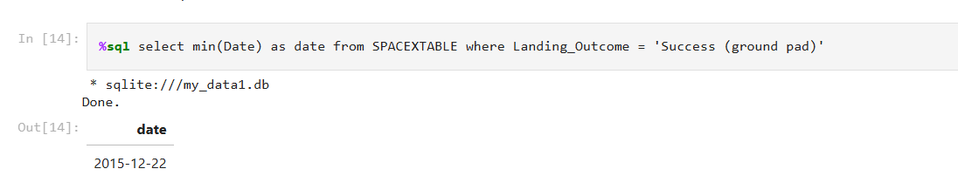
First Successful Ground Landing Date
Find the dates of the first successful landing outcome on ground pad
Min function is used to find the date of the first successful landing outcome on ground pad

Slide 32
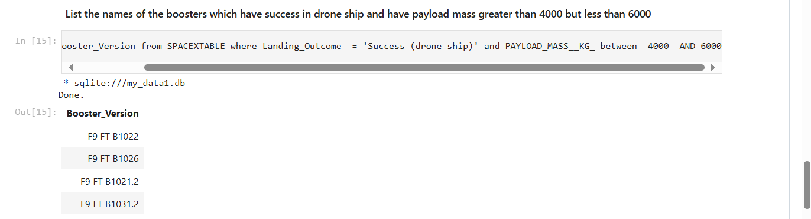
Successful Drone Ship Landing with Payload between 4000 and 6000
List the names of boosters which have successfully landed on drone ship and had payload mass greater than 4000 but less than 6000
Between keyword is used to find the payload mass between 4000 to 6000

Slide 33
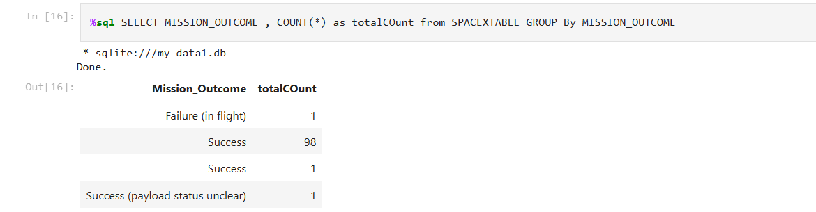
Total Number of Successful and Failure Mission Outcomes
Calculate the total number of successful and failure mission outcomes
Count function is used to find total number of mission outcomes and group by is used to group the successful and failure mission outcomes

Slide 34
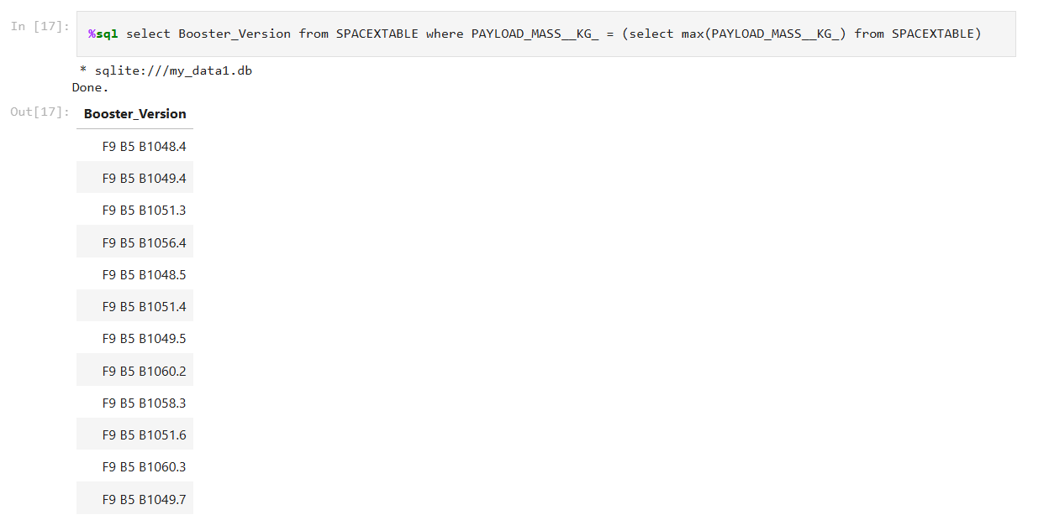
Boosters Carried Maximum Payload
List the names of the booster which have carried the maximum payload mass
Max function is used in the subquery to list the booster names which have carried maximum payload

Slide 35
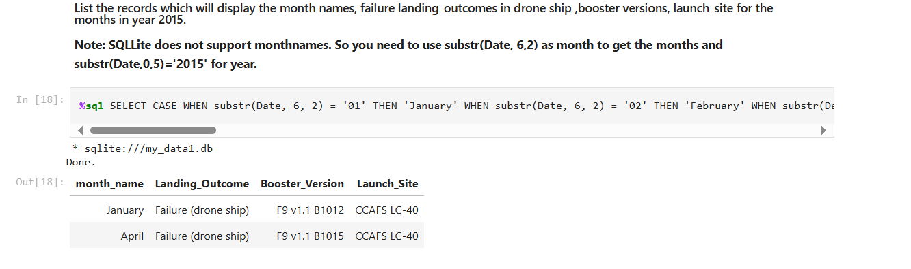
2015 Launch Records
List the failed landing_outcomes in drone ship, their booster versions, and launch site names for in year 2015
SELECT CASE WHEN substr(Date, 6, 2) = '01' THEN 'January' WHEN substr(Date, 6, 2) = '02' THEN 'February' WHEN substr(Date, 6, 2) = '03' THEN 'March' WHEN substr(Date, 6, 2) = '04' THEN 'April' WHEN substr(Date, 6, 2) = '05' THEN 'May' WHEN substr(Date, 6, 2) = '06' THEN 'June' WHEN substr(Date, 6, 2) = '07' THEN 'July' WHEN substr(Date, 6, 2) = '08' THEN 'August' WHEN substr(Date, 6, 2) = '09' THEN 'September' WHEN substr(Date, 6, 2) = '10' THEN 'October' WHEN substr(Date, 6, 2) = '11' THEN 'November' WHEN substr(Date, 6, 2) = '12' THEN 'December' END AS month_name, landing_outcome, booster_version, launch_site FROM SPACEXTABLE where Landing_Outcome='Failure (drone ship)' and substr(Date, 0, 5)='2015’
Substr function is used to get the month and year from Date and CASE is used to display month_name as a string

Slide 36
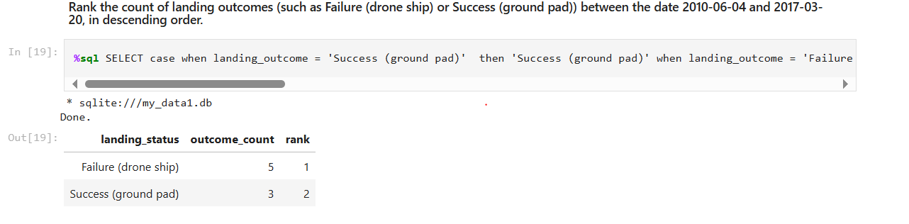
Rank Landing Outcomes Between 2010-06-04 and 2017-03-20
Rank the count of landing outcomes (such as Failure (drone ship) or Success (ground pad)) between the date 2010-06-04 and 2017-03-20, in descending order
SELECT case when landing_outcome = 'Success (ground pad)' then 'Success (ground pad)' when landing_outcome = 'Failure (drone ship)' then 'Failure (drone ship)' end as landing_status, COUNT(*) as outcome_count, RANK() OVER (ORDER BY COUNT(*) DESC) AS rank from SPACEXTABLE where date between '2010-06-04' and '2017-03-20' and (landing_status = 'Failure (drone ship)' OR landing_status = 'Success (ground pad)') group by landing_status ORDER BY outcome_count desc
COUNT is used to get the total count and rank is used to get the rank from SPACEXTable based on count and ORDER by is used to display the records in descending order

Slide 37

Section 3

Slide 38
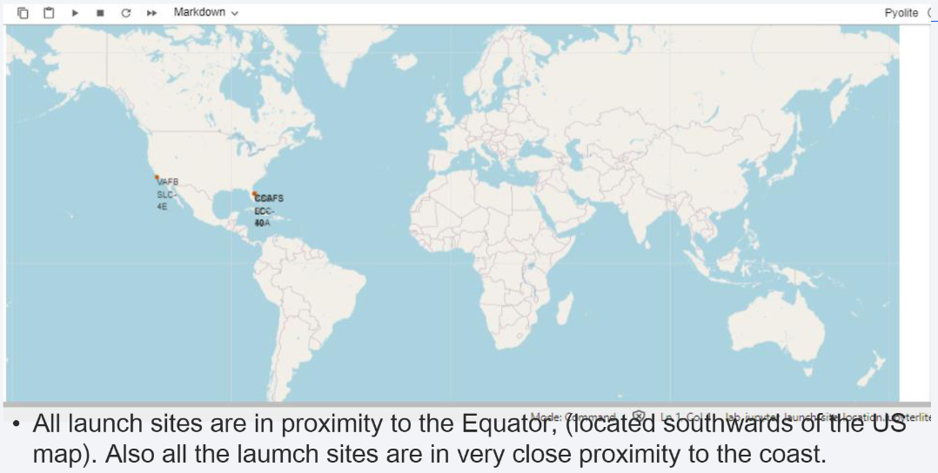
Markers of All Launch Sites on Global map

Slide 39
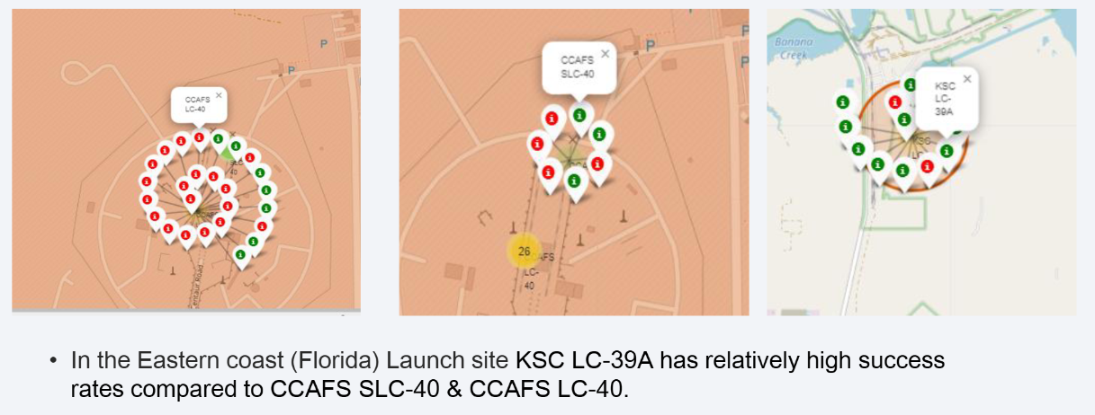
Launch Outcomes for each site on the map with color markers

Slide 40
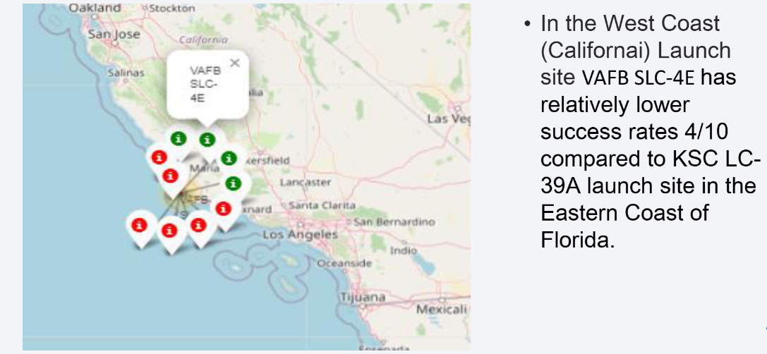
Launch Outcomes for Each Site on the Map with Color Markers

Slide 41

Section 4

Slide 42
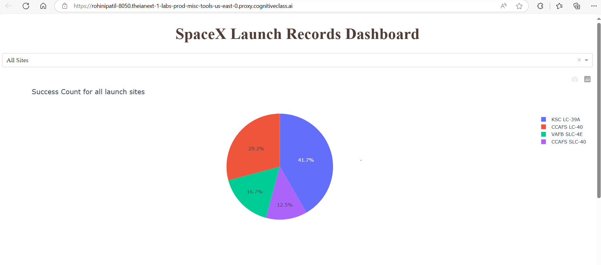
Pie Chart for All Sites Launch Success Count
Launch Site KSCLC-39A has the highest Success rate at 42% followed by CCAFS LC 40 at 29%

Slide 43
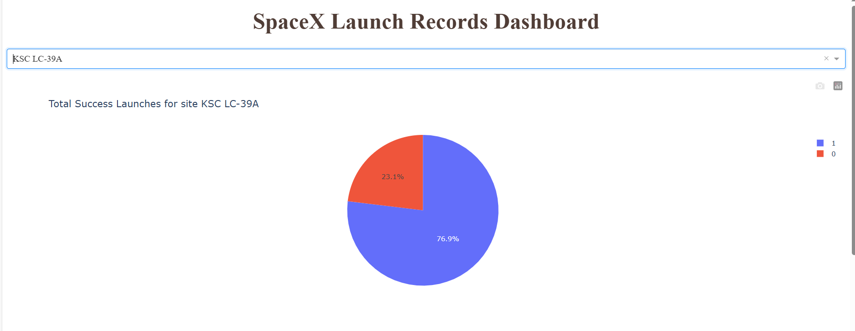
Pie chart for Highest Success rate launch Site
KSC LC-39A has the Highest Success rate at 76.9% against 23.1% failed launches.

Slide 44
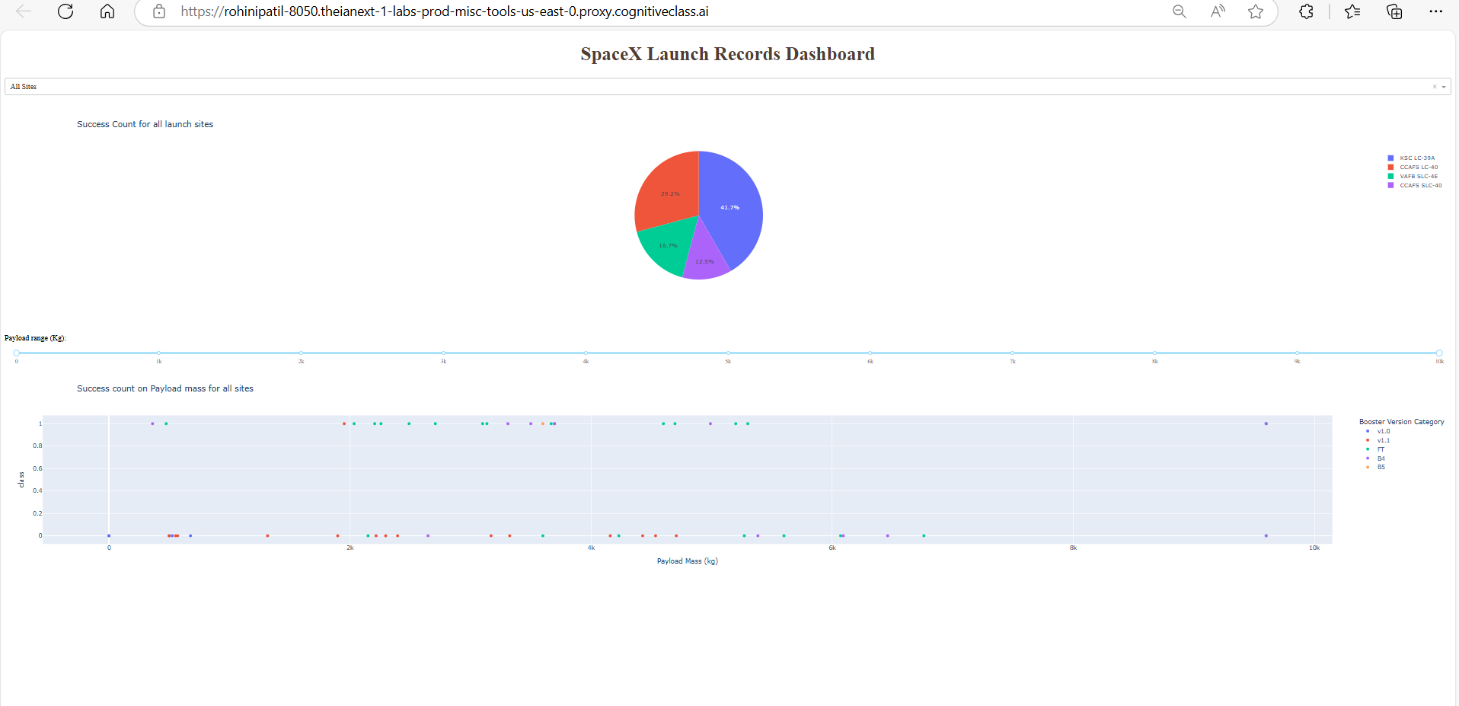
Payload vs Launch Outcome scatter plot for all sites
Booster version FT has the largest success rate

Slide 45

Section 5

Slide 46
Classification Accuracy
All the methods perform equally on the test data. They all have the same accuracy of 0.833333 on the test data

Slide 47
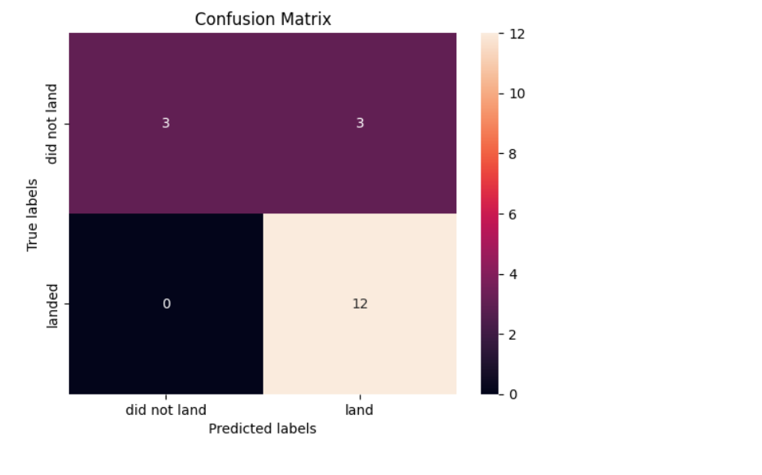
Confusion Matrix
All the 4-classification model had the same confusion matrix and were able equally distinguish between different classes. The major problem is false positives for all the models

Slide 48
Conclusions
Different launch sites have different success rates. CCAFS LC-40 has a success rate of 60%, while KSC LC-39A and VAFB SLC 4E has a success rate of 77%.
We can deduce that, as the flight number increases in each of the 3 launch sites, so does the success rate. For instance, the success rate for the VAFB SLC 4E launch site is 100% after the Flight number 50. Both KSC LC 39A and CCAFS SLC 40 have a 100% success rates after 80th flight.
If you observe Payload Vs. Launch Site scatter point chart you will find for the VAFB-SLC launchsite there are no rockets launched for heavy payload mass (greater than 10000).
Orbits ES-L1, GEO, HEO & SSO have the highest success rates at 100%, with SO orbit having the lowest success rate at ~50%. Orbit SO has 0% success rate.
LEO orbit the Success appears related to the number of flights; on the other hand, there seems to be no relationship between flight number when in GTO orbit.
With heavy payloads, the successful landing or positive landing rate is more for Polar, LEO, and ISS.
However, for GTO, we cannot distinguish this well, as both positive landing rate and negative landing (unsuccessful mission) are both there.
And finally, the success rate since 2013 kept increasing till 2020.

Slide 49


